Slide 1
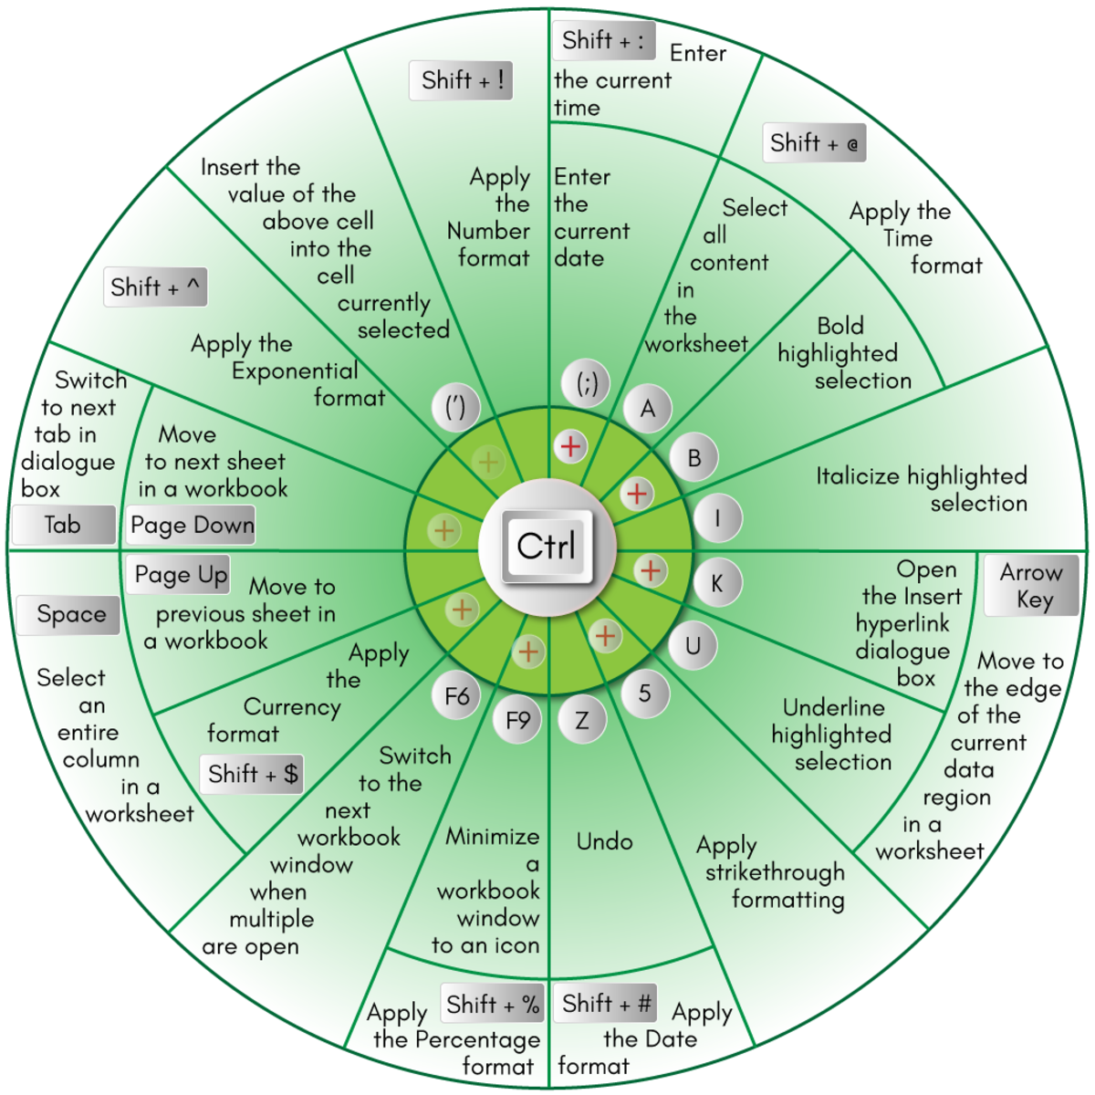
Navigation & selection shortcut keys in Excel
Notes:
https://analystcave.com/microsoft-excel-shortcut-keys/

Slide 2
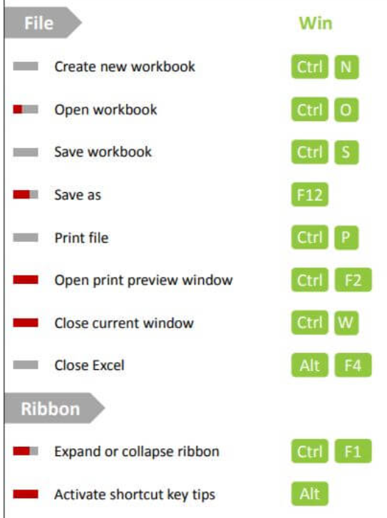
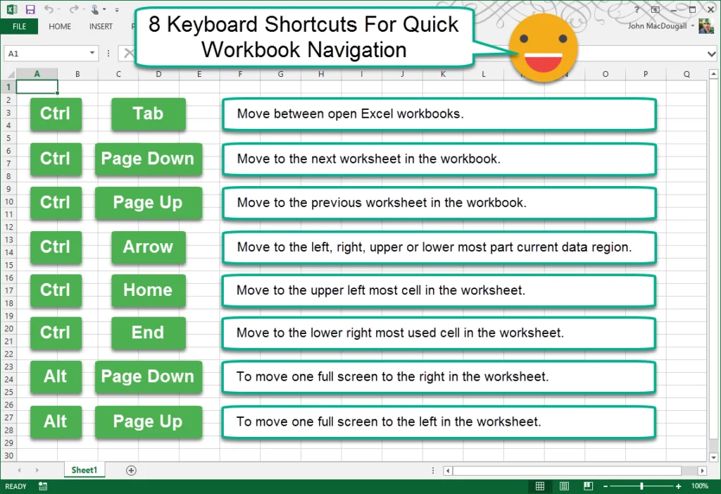
Navigation

Slide 3
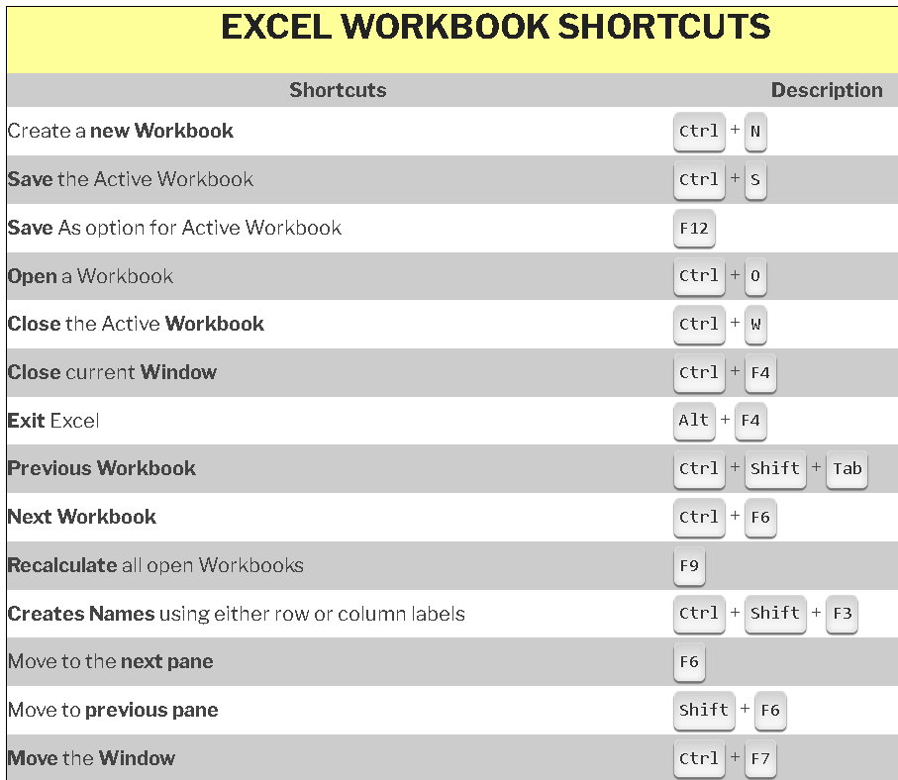

Slide 4
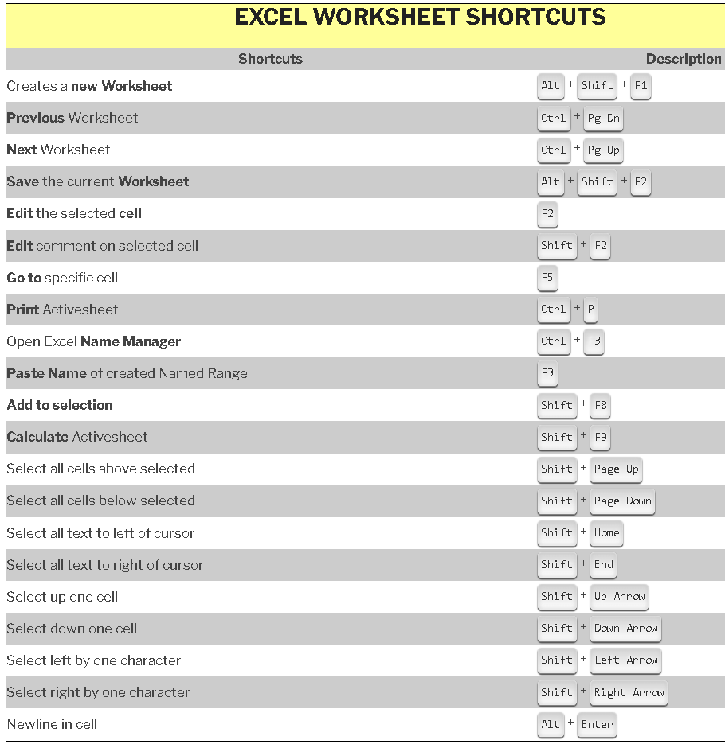

Slide 5
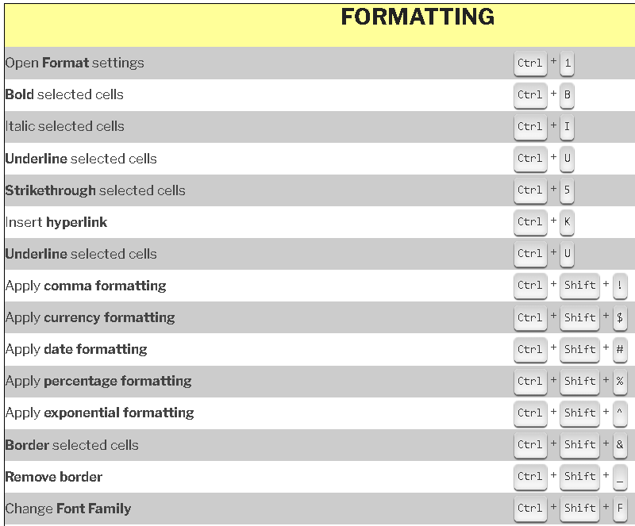

Slide 6
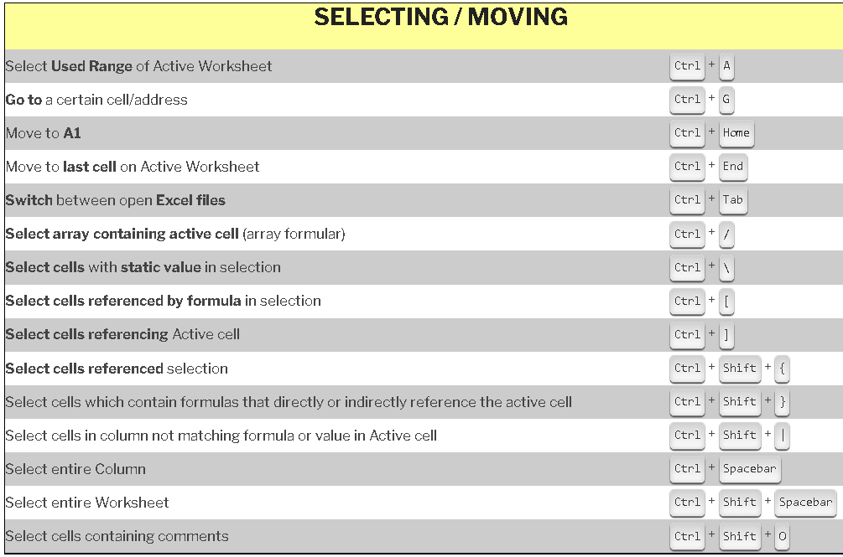

Slide 7
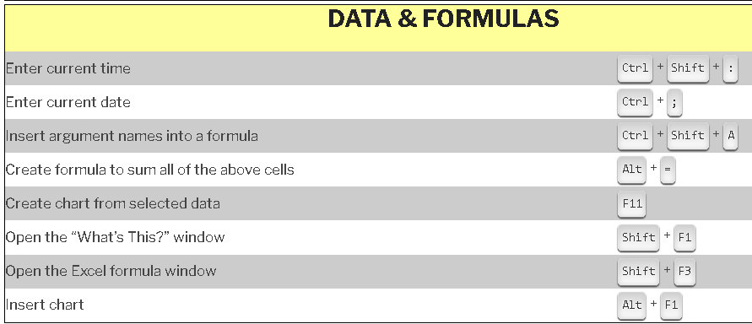

Slide 8
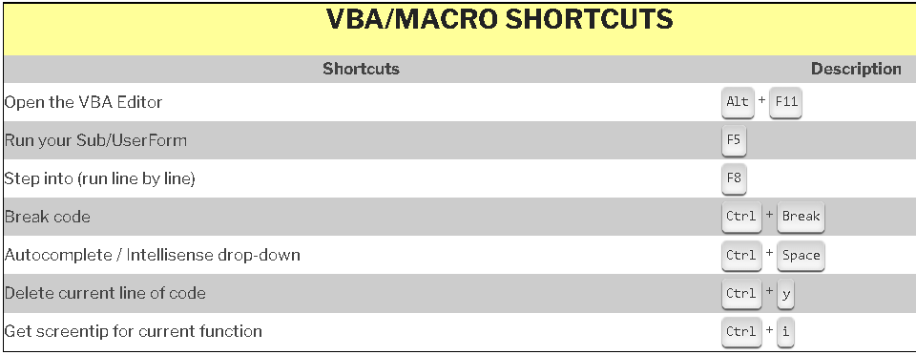

Slide 9
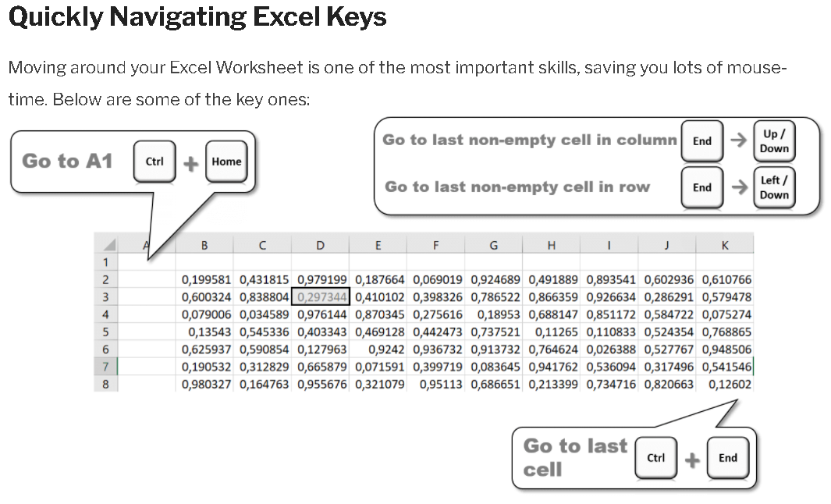

Slide 10
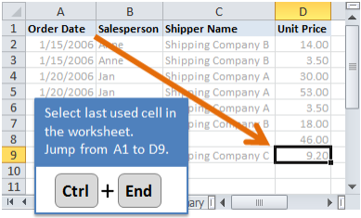
Navigation
TO: | PRESS
Move to the edge of the current data region | CTRL+ arrow key
Move between unlocked cells on a protected worksheet | TAB
Move to the beginning of the row | HOME
Move to the beginning of the worksheet | CTRL+HOME
Move to the last cell on the worksheet, which is the cell at the intersection of the right-most used column and the bottom-most used row (in the lower-right corner); cell opposite the Home cell, which is typically A1 | CTRL+END
Move down one screen | PAGE DOWN
Move up one screen | PAGE UP
Move one screen to the right | ALT+PAGE DOWN
Move one screen to the left | ALT+PAGE UP
Move to the next sheet in the workbook | ^ PAGE DOWN
Move to the previous sheet in the workbook | ^ PAGE UP
Move to the next workbook or window | CTRL+F6 or CTRL+TAB
Move to the previous workbook or window | CTRL+SHIFT+F6 or CTRL+SHIFT+TAB
Move to the next pane | F6
Move to the previous pane | SHIFT+F6
Scroll to display the active cell | CTRL+BACKSPACE

Slide 11
Select cells, columns, rows, or objects
TO | PRESS
Select the current region around the active cell (the current region is an area enclosed by blank rows and blank columns) | ^* (ASTERISK)
Extend the selection by one cell | SHIFT+ arrow key
Extend the selection to the last nonblank cell in the same column or row as the active cell | ^SHIFT+ arrow key
Extend the selection to the beginning of the row | SHIFT+HOME
Extend the selection to the beginning of the worksheet | ^SHIFT+HOME
Extend the selection to the last cell used on the worksheet (lower-right corner) | ^SHIFT+END
Select the entire column | ^SPACEBAR
Select the entire row | SHIFT+SPACEBAR
Select the entire worksheet | CTRL+A
If multiple cells are selected, select only the active cell | SHIFT+BACKSPACE
Extend the selection down one screen | SHIFT+PAGE DOWN
Extend the selection up one screen | SHIFT+PAGE UP
With an object selected, select all objects on a sheet | CTRL+SHIFT+SPACEBAR
Alternate between hiding objects, displaying objects, and displaying placeholders for objects | CTRL+6
Show or hide the Standard toolbar | CTRL+7

Slide 12
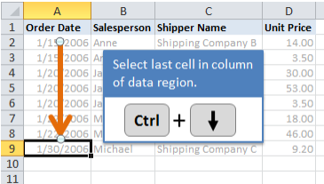
CTRL combination shortcut keys
Key | Description
CTRL+PgUp / PgDn | Switches between worksheet tabs, from left-to-right / right-to-left.
CTRL+SHIFT+( | Unhides any hidden rows within the selection.
CTRL+SHIFT+& | Applies the outline border to the selected cells.
CTRL+SHIFT_ | Removes the outline border from the selected cells.
CTRL+SHIFT+ | applies the: .
~ | General number format.
$ | Currency format with 2 decimal places (negative numbers in parentheses).
% | Percentage format with no decimal places.
^ | Scientific number format with two decimal places.
# | Date format with the day, month, and year.
@ | Time format with the hour & minute, and AM or PM.
! | Number format with 2 decimal places, thousands separator, and minus sign (-)
* | Selects the current region around the active cell (the data area enclosed by blank rows and blank columns).

Slide 13
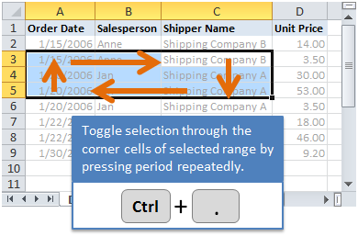
CTRL+SHIFT+: | Enters the current time.
CTRL+SHIFT+" | Copies the value from the cell above the active cell into the cell or the Formula Bar.
CTRL+SHIFT+Plus (+) | Displays the Insert dialog box to insert blank cells.
CTRL+Minus (-) | Displays the Delete dialog box to delete the selected cells.
CTRL+; | Enters the current date.
CTRL+` | Alternates between displaying cell values & formulas in the worksheet.
CTRL+' | Copies a formula from the cell above the active cell into the cell or the Formula Bar.
CTRL+1 | Displays the Format Cells dialog box.
CTRL+9 | Hides the selected rows.
CTRL+0 | Hides the selected columns.
CTRL+A | Selects the entire worksheet. If the worksheet contains data, CTRL+A selects the current region. Pressing CTRL+A a second time selects the entire worksheet. When the insertion point is to the right of a function name in a formula, displays the Function Arguments dialog box. CTRL+SHIFT+A inserts the argument names and parentheses when the insertion point is to the right of a function name in a formula.
CTRL+F | Displays the Find and Replace dialog box, with the Find tab selected. SHIFT+F5 also displays this tab, while SHIFT+F4 repeats the last Find action. CTRL+SHIFT+F opens the Format Cells dialog box with the Font tab selected.
CTRL+G | Displays the Go To dialog box. F5 also displays this dialog box.
CTRL+K | Displays the Insert Hyperlink dialog or the Edit Hyperlink dialog box for selected existing hyperlinks.
CTRL+N | Creates a new, blank workbook.
CTRL+O | Displays the Open dialog box to open or find a file. CTRL+SHIFT+O selects all cells that contain comments.
CTRL+T | Displays the Create Table dialog box.
CTRL+SHIFT+U | switches between expanding & collapsing of the formula bar.

